Slide 1

Innovator Island
Serverless web app for a theme park
Onkar Deokate
onkardeokate@gmail.com

Slide 2

Submitted to
Manipal University Jaipur
towards the partial fulfillment for the award of the degree of
Bachelor of Technology in Computer & Communication Engineering
By
Onkar Deokate( 219303061)
Under the Guidance of
Ms. Anshika Malsaria

Slide 3
Introduction
This document aims to provide a comprehensive understanding of the system's architecture, components, features, and deployment procedures.
The Theme Park Management System is a sophisticated solution designed to efficiently manage the operations of a theme park, offering a range of functionalities including
real-time updates,
photo processing,
multilingual support,
analytics, and
event-driven notifications.

Slide 4
Prerequisite
An AWS account with appropriate permissions.
Installation of AWS Cloud9 IDE for development purposes.
Git installed on your local machine.
Node.js runtime environment.
Amplify CLI and SAM CLI for streamlined deployment procedures.

Slide 5
Purpose : What & Why?
Theme park management software provides solutions that can streamline the tasks and duties that managers are responsible for.
Much like resorts and other tourist attractions, theme parks must offer certain amenities to their guests, including restrooms, entertainment, and dining establishments.
A successful amusement park strategy emphasizes the full customer experience, including parking, roller coasters, stage shows, food options, water parks, live animal attractions, arcade games, appealing landscaping, and family-oriented fun.
The larger property, the more entertainment options are there for the visitors

Slide 6













AWS Services Used
AWS Amplify
AWS CodeCommit
AWS Cloud9
AWS
Lambda
Amazon API Gateway
Amazon S3
Amazon QuickSight
Amazon EventBridge
Amazon DynamoDB
Amazon SNS
AWS
IoT Core

Slide 7
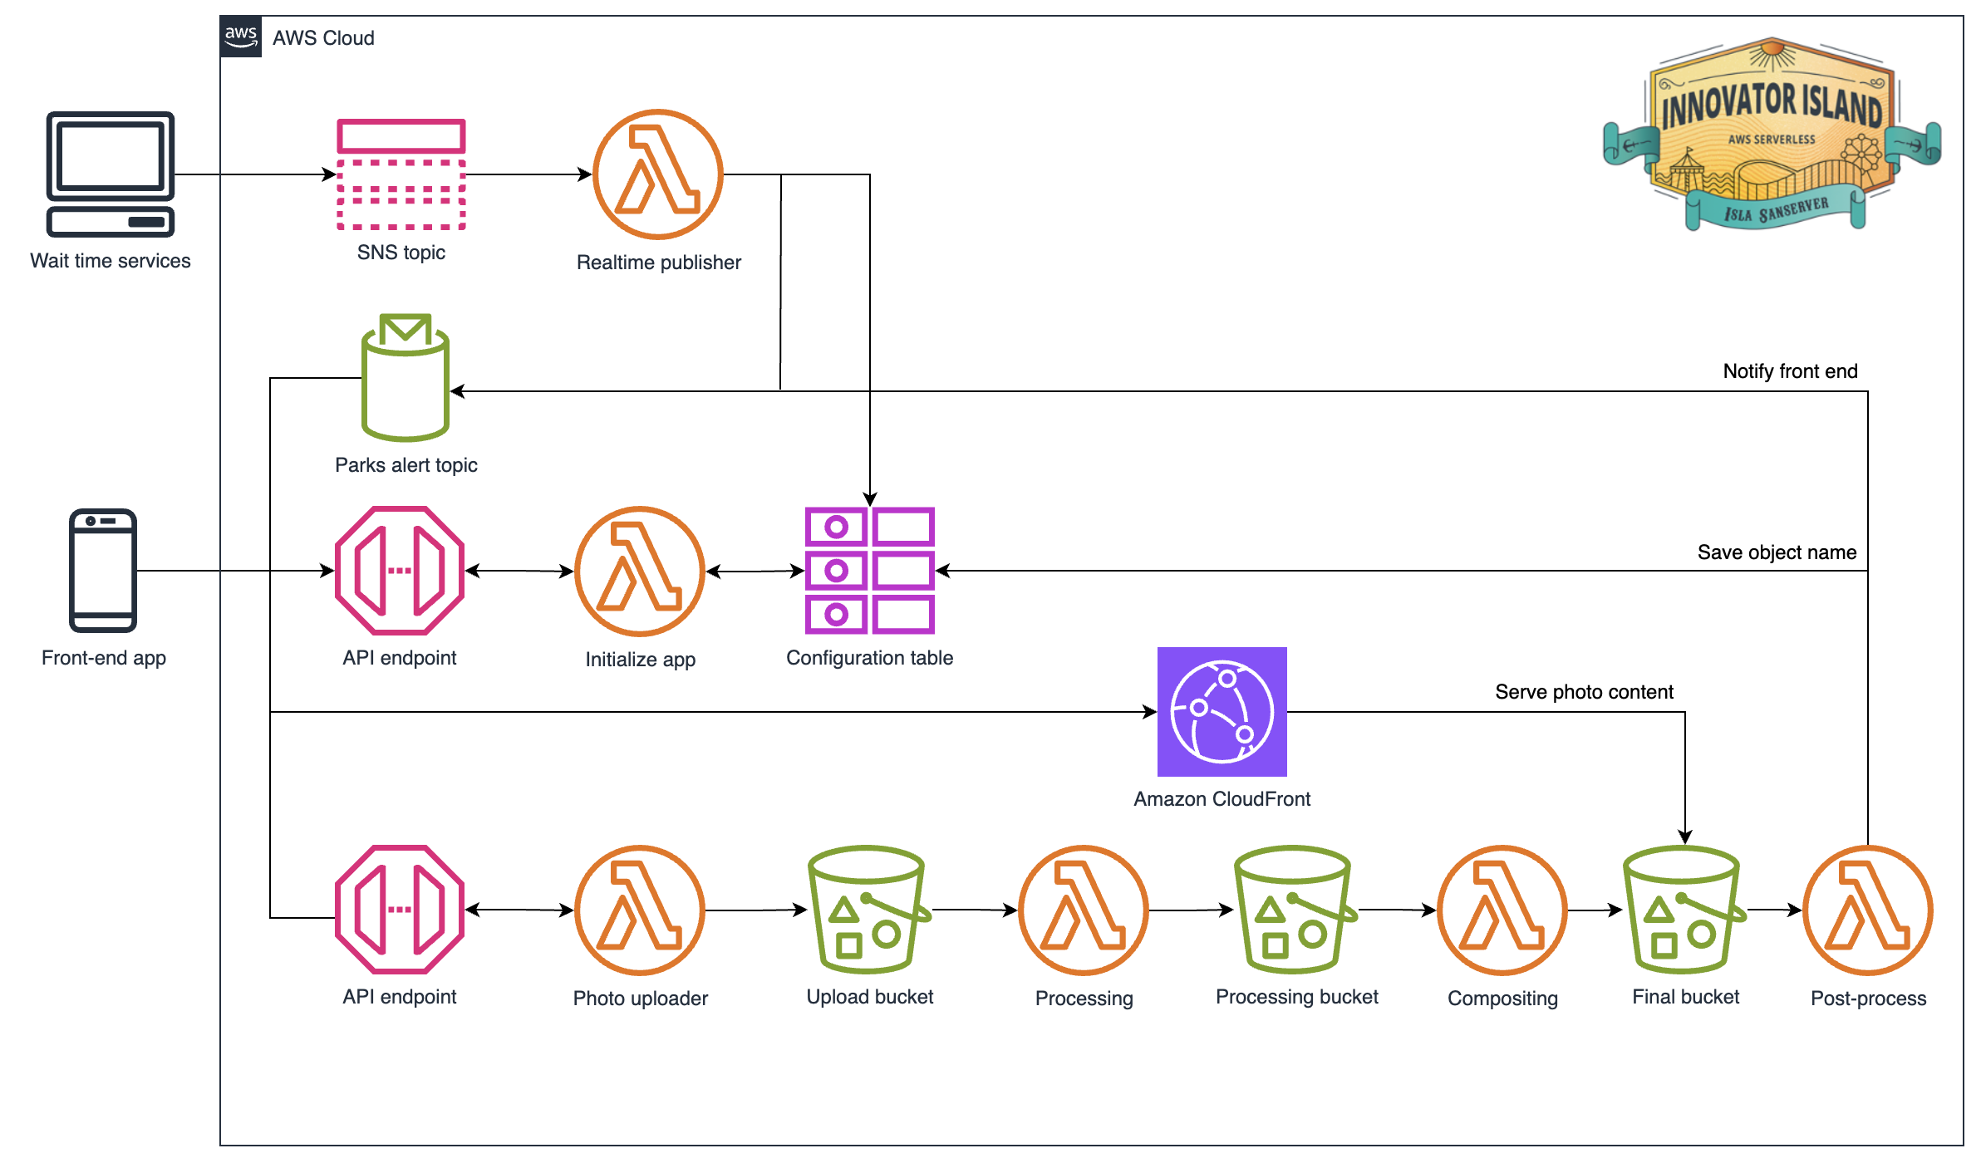
Architecture

Slide 8

AWS Cloud9
Fully featured cloud-based IDE
Integrated tools for serverless development
Built-in terminal and temp space
Provisioned bandwidth in AWS network (not dependent on Wi-Fi)

Slide 9
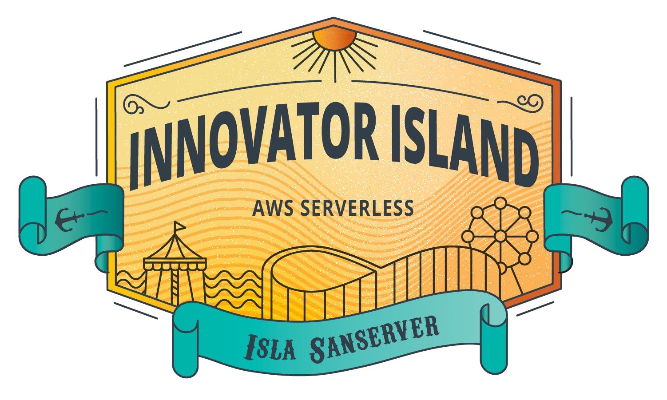
#InnovatorIsland

Slide 10
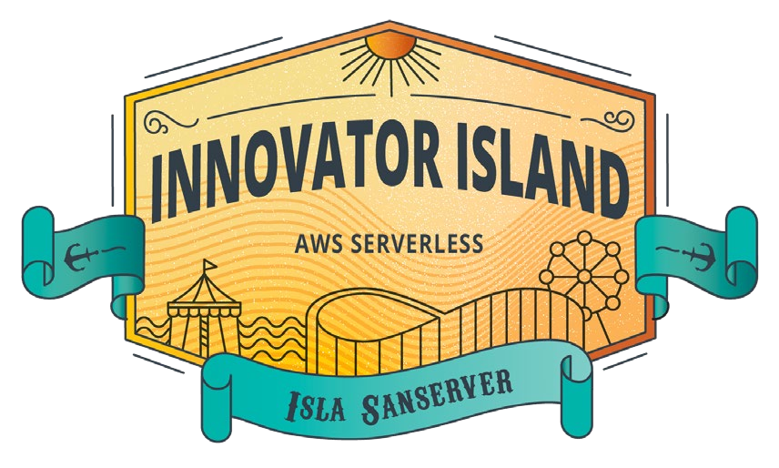




System Overview
Amplify
CodeCommit
AWS Cloud9
AWS Cloud9

Slide 11
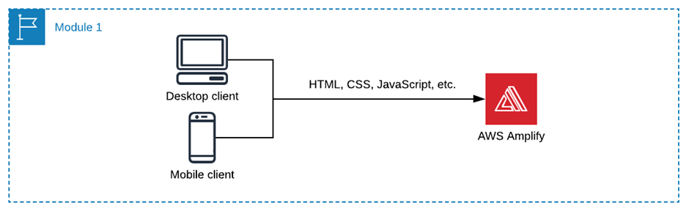
Frontend Configuration
The frontend application is seamlessly hosted on AWS Amplify Console, providing an integrated Git-based workflow for continuous deployment.
It encompasses static web resources, comprising HTML, CSS, JavaScript, and image files, meticulously served via Amazon S3

Slide 12
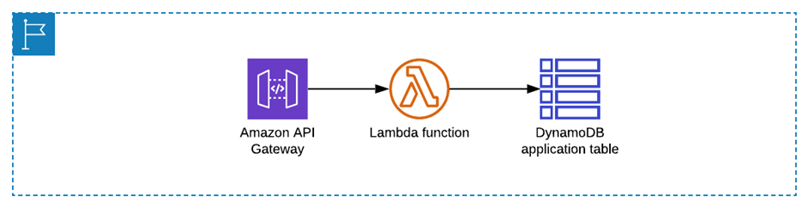
Backend Infrastructure
The backend infrastructure is meticulously constructed utilizing AWS serverless services orchestrated via AWS SAM.
It encompasses AWS Lambda functions, driving core business logic, API Gateway for seamless RESTful API creation, S3 buckets for static asset storage, DynamoDB tables for persistent data storage, Cognito for secure user authentication, and CloudFront for optimized content delivery.

Slide 13



Ride Wait-Time
Wait times service
SNS topic
Realtime publisher
Notify frontend
Save object name
Upload Processing ^{Processing Bucket} Compositing ^{Final} Post-process _{Bucket} Bucket
Park alerts topic
Frontend app
API endpoint Initialize app
API endpoint Photo Uploader
Configuration table

Slide 14
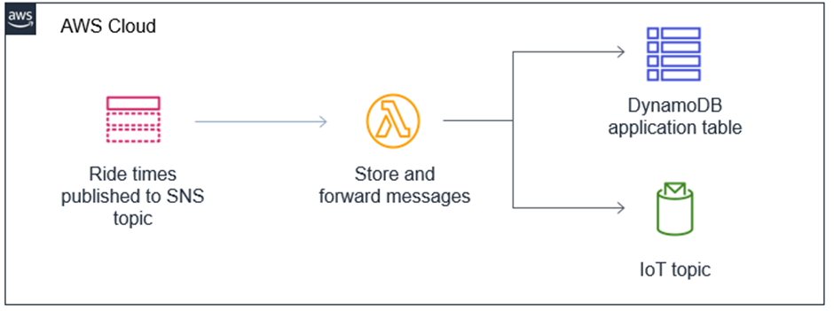
Real-time Features
Real-time ride updates are seamlessly disseminated to park visitors leveraging AWS Lambda functions, SNS topics, and IoT Core.
Periodic updates are systematically published to a designated SNS topic, subsequently triggering Lambda functions to fetch, process, and disseminate the latest ride data sourced from DynamoDB

Slide 15
Ways to interact between front-end and back-end
API Gateway – synchronous request and response.
API Gateway – WebSockets.
API Gateway – asynchronous request with polling.
API Gateway – asynchronous request with webhooks.
IoT Core – realtime pub/sub over MQTT.

Slide 16







Publish/Subscribe
Topic A
Subscriber 1
Publisher
Topic B
Subscriber 2
Topic C
Subscriber 3
Subscriber 4
Subscriber 5

Slide 17







Publish/Subscribe with AWS IoT Core
Topic A
Subscriber 1
Publisher
Topic B
Subscriber 2
Topic C
Subscriber 3
Subscriber 4
Subscriber 5
await iotdata.publish({ topic: "theme-park-rides", qos: 0,
payload: message
}).promise()
// A message has arrived mqttClient.on('message', (topic, payload) => {
if (topic === "theme-park-rides") {
// Save/process ride times
}
})
IoT topics

Slide 18
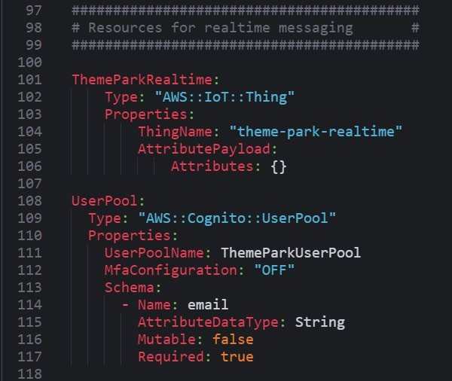
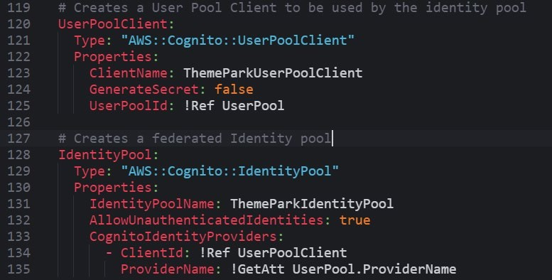
Setting up the IoT Core resources in SAM

Slide 19
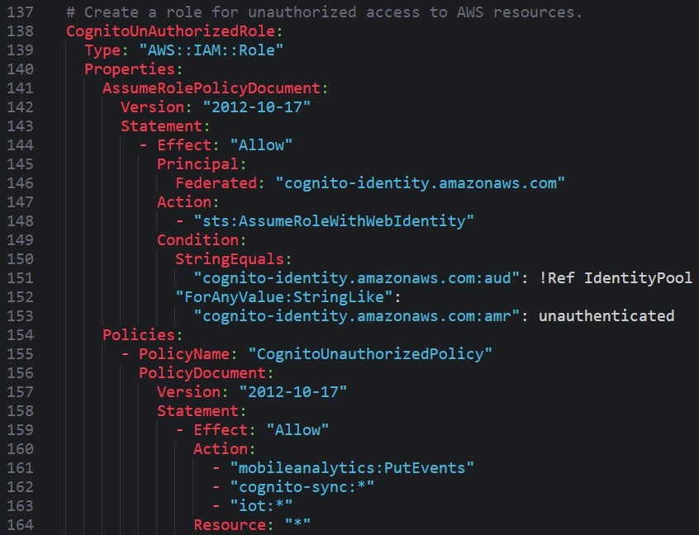
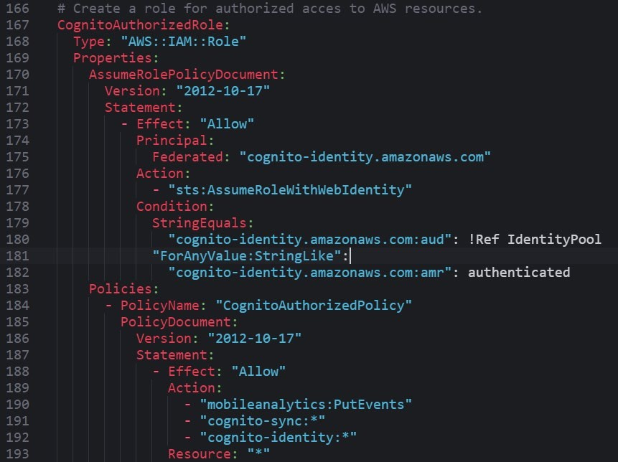
Setting up the Cognito roles in SAM

Slide 20


Ride photos
SNS topic Realtime
Wait times service _{publisher}
Notify frontend
Park alerts topic
Save object name
API endpoint Initialize app Configuration table
Frontend app
API endpoint
Photo uploader
Upload bucket
Processing
Processing bucket
Compositing
Final bucket
Post-process

Slide 21
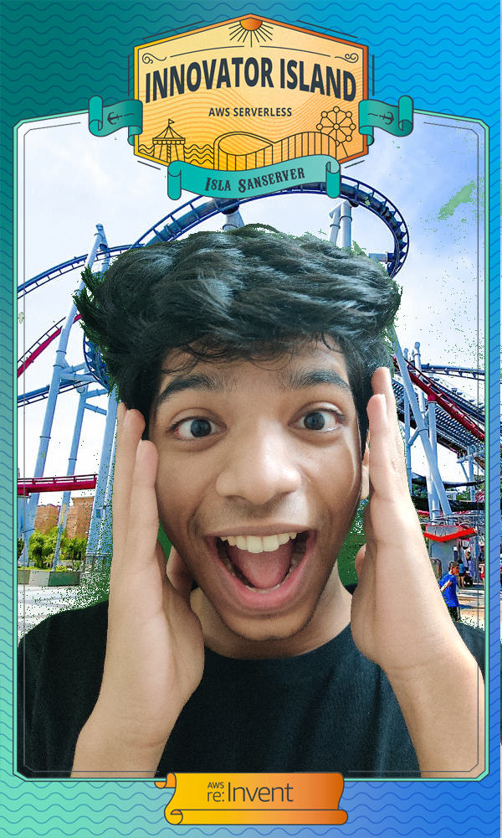

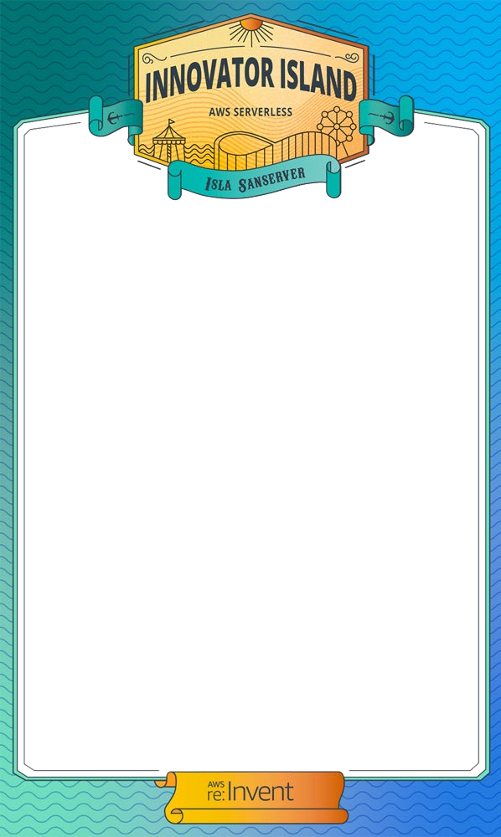
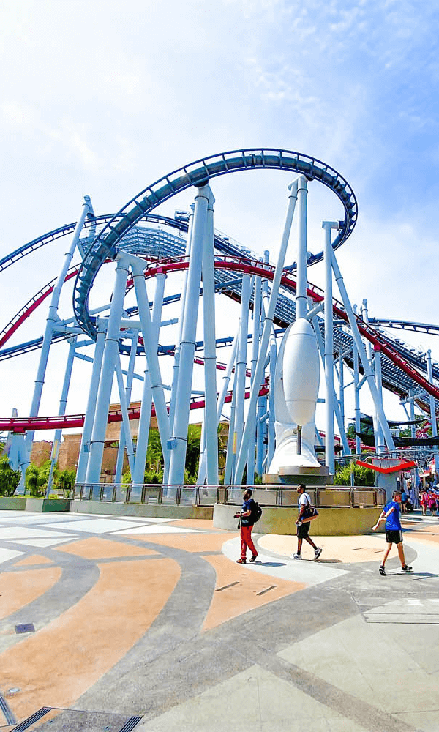
Ride photos
1
Frontend app
API endpoint
Photo uploader
2
Frontend app
Upload bucket
Processing
Processing bucket
Compositing
Final bucket
Post-process

Slide 22
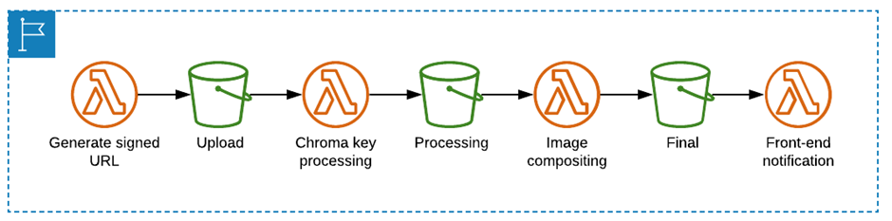
On-ride Photo Processing
Park visitors are afforded the opportunity to capture and personalize on-ride photos through the photo processing feature.
Upon photo upload, Lambda functions execute chromakey processing to eliminate background elements, conduct compositing to embed theme park graphics, and undertake post-processing to finalize the image

Slide 23
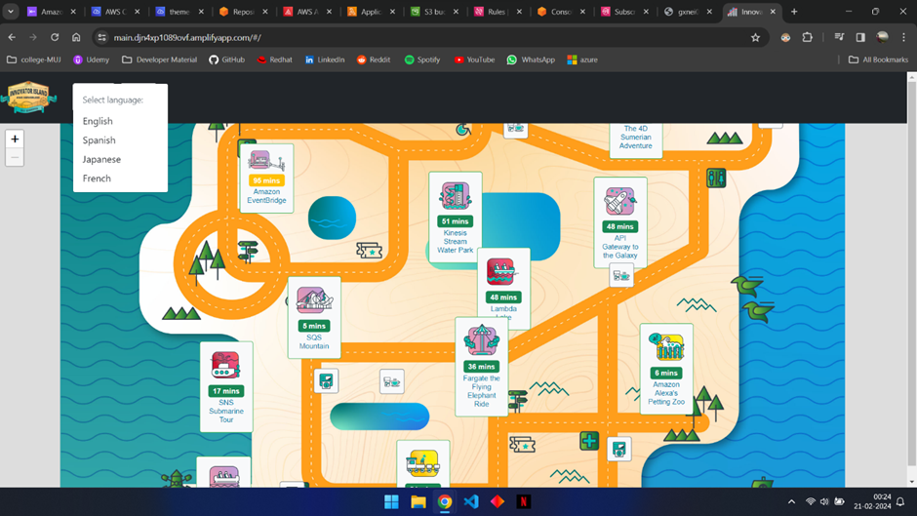
Translation Support : 4 Language Support
The frontend application extends support for multilingual translations, enhancing accessibility for diverse audiences.
Amazon Translate is judiciously employed to generate translations for resource files, systematically deployed through Amplify Console.
Visitors are empowered to seamlessly toggle between diverse languages, thereby accessing park information and directives in their preferred language.

Slide 24



Backend Overview
AWS Cloud9
AWS
Lambda
Amazon SNS
Amazon CloudWatch
Amazon EventBridge

Slide 25
CloudWatch– part 1
SNS Topic Flow & Traffic Controller
theme-park-events- PublishFunction
EventBridge default event bus
{
{
Source: "themepark.rides", EventBusName: "default", DetailType: "waitTimesSummary", Time: 1591963573392,
Detail: "{"rideId":"ride- 010","inService":true,"wait":45,"lastUp dated":1591963573392}"
}
rideId: "ride-010", inService: true, wait: 45,
lastUpdated: 1591963573392
}

Slide 26

CloudWatch– part 1
SNS Topic theme-park-events- Flow & PublishFunction Traffic
Controller
EventBridge default event bus
EventBridge rule
theme-park-events- MetricsFunction
CloudWatch Metrics
{
"source": [ "themepark.rides"
],
"detail-type": [ "waitTimesSummary"
]
}

Slide 27
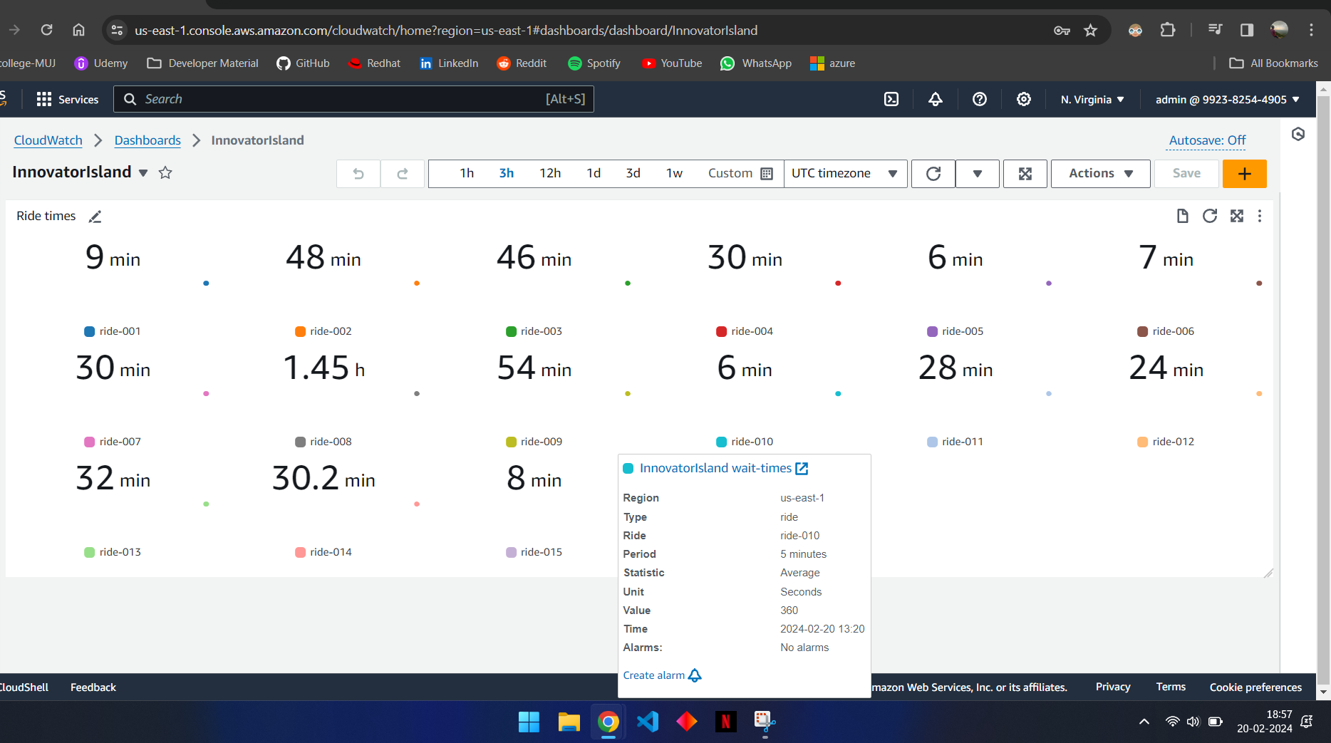
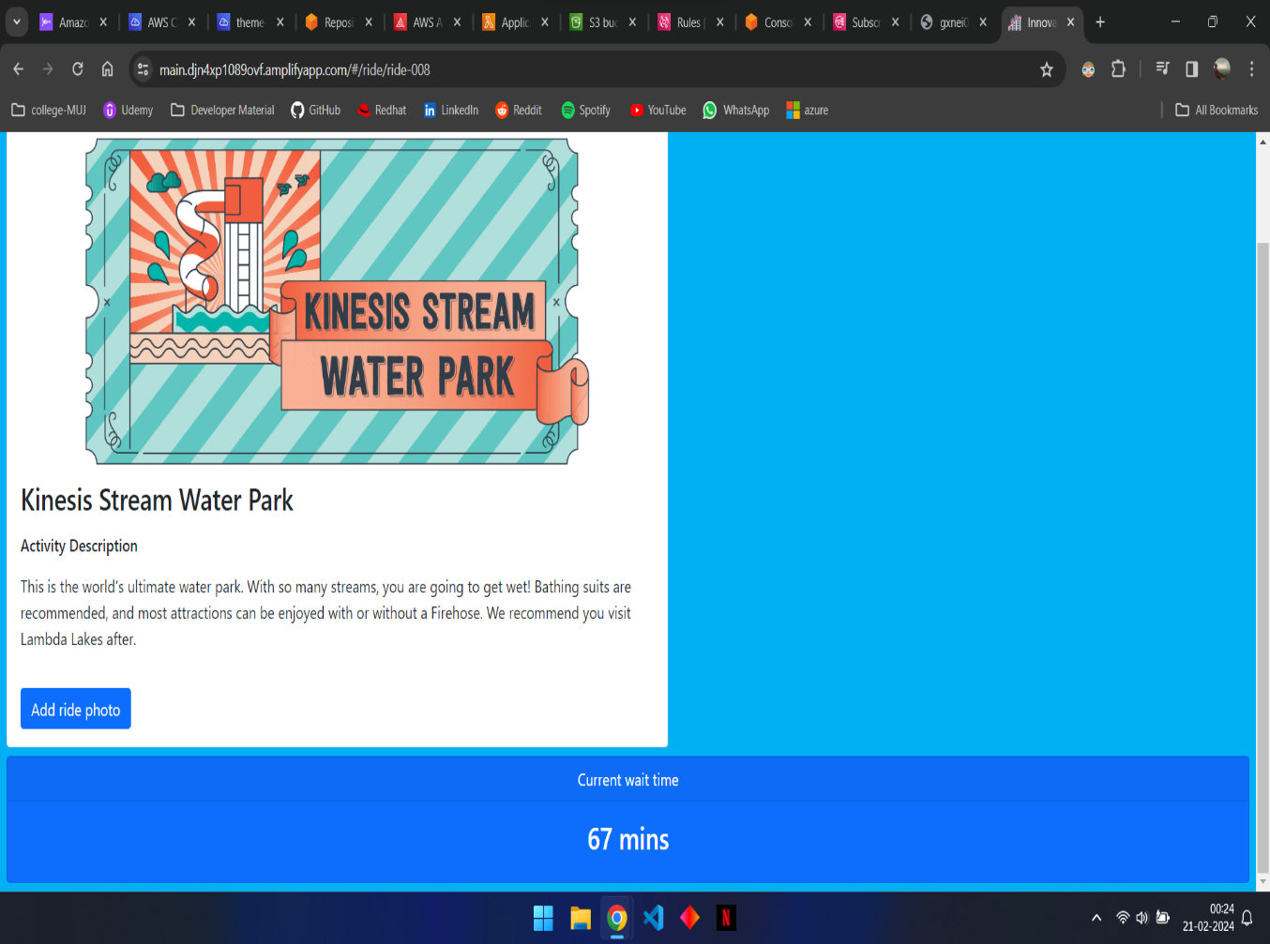
CloudWatch – Wait Time Summary

Slide 28

SNS – part 2
{
"rideId": "ride-009",
"type": "Info",
"description": "Removing ride vehicle"
{
"source": [ "themepark.rides"
],
"detail-type": [ "waitTimes"
],
"detail": {
"inService": [ false
]
}
"timeToResolution": 15
},
{
"rideId": "ride-012",
"type": "Warning"
"description": "Passenger alert - sickness"
"timeToResolution": 20
Outages
},
{
theme-park-events- PublishFunction
"rideId": "ride-015",
"type": "Emergency"
"description": "Evacuating riders"
}
"timeToResolution": 60
}
EventBridge default event bus

Slide 29
SNS – part 2
{
"source": [ "themepark.rides"
],
"detail-type": [ "waitTimes"
],
"detail": {
"inService": [ false
]
}
Outages
theme-park-events- PublishFunction
}
EventBridge default event bus

Slide 30
Email & SMS Alerts
Informational alerts
SNS Topic Sends email
Emergency alerts
SNS Topic Sends SMS
EventBridge default event bus

Slide 31
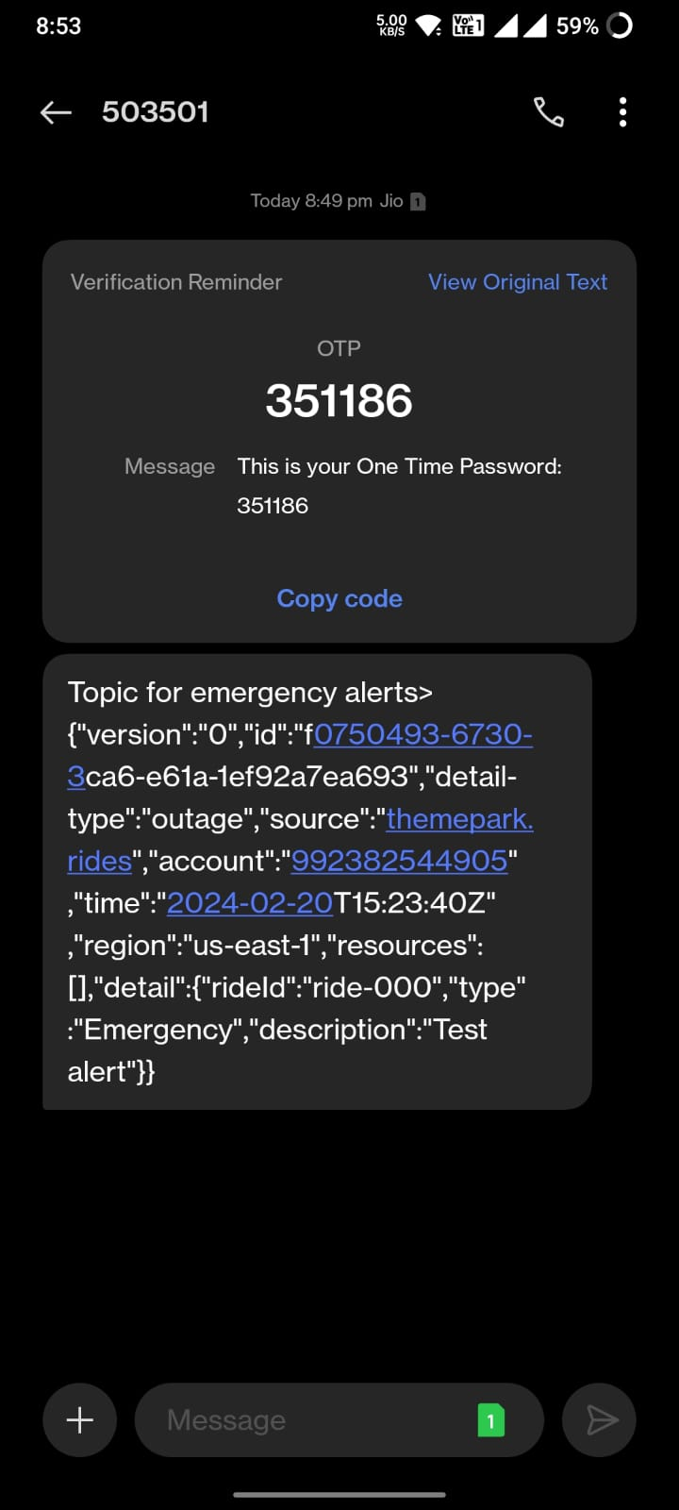
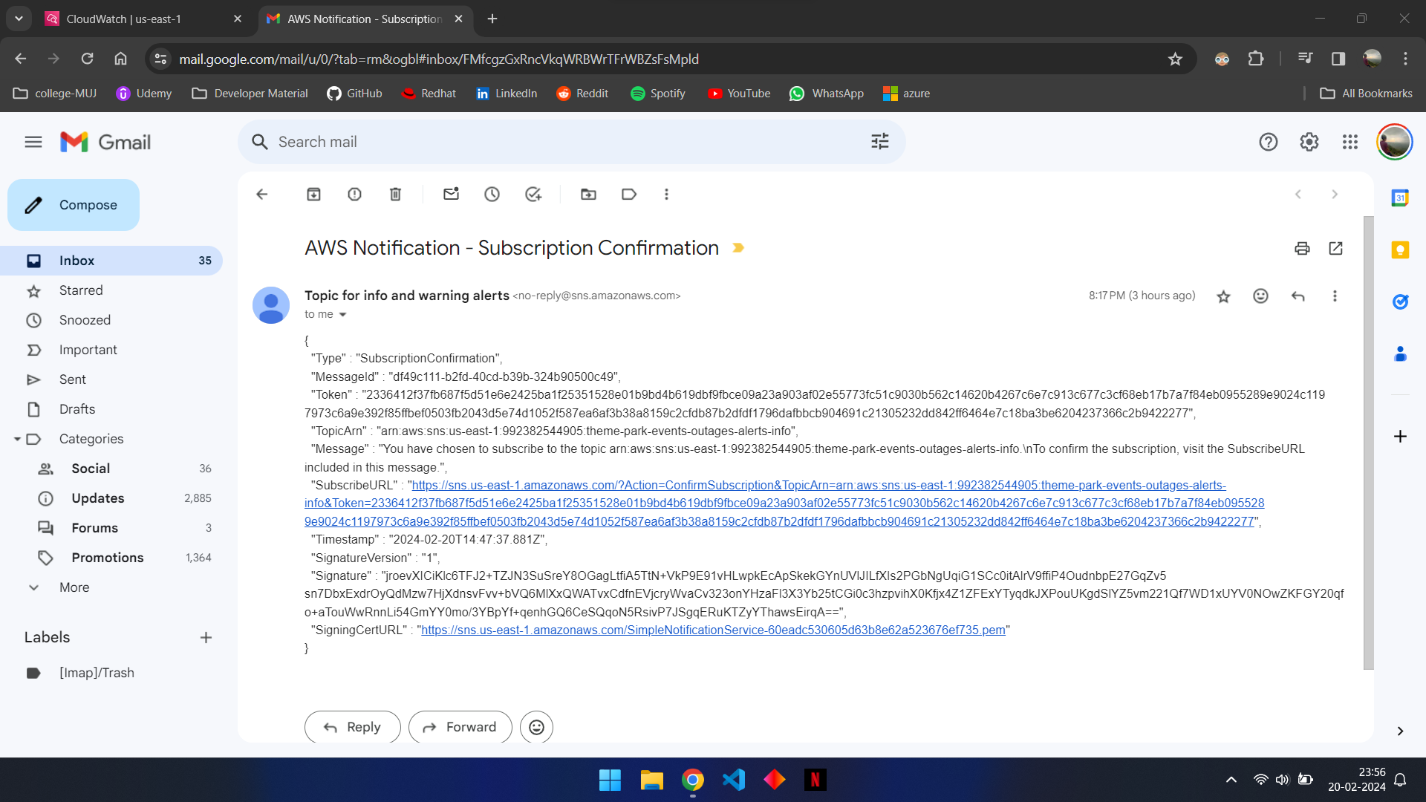
SNS Output

Slide 32
https://main.djn4xp1089ovf.amplifyapp.com/#/

Slide 33
Thank you!
Onkar Deokate
219303061
BTech CCE 6A
Manipal University Jaipur

